Slide 1
Digital Portfolio
STUDENT NAME: S. SANDHIYA
REGISTER NO AND NMID: asbrubz2422K2713
DEPARTMENT: Bsc (computer science)
COLLEGE: COLLEGE/ UNIVERSITY: GOVT ARTS AND SCIENCE COLLEGE AHTHIYUR
BHARTHIYAR UNIVERSITY COIMBUTHUR

Slide 2
PROJECT TITLE
Protifolito: A Digital Portfolio System
Portfolio:Creative Online Portfolio
Portfolio: Showcasing Skills and Projects
Protifolio: A Modern Personal Portfolio Website
Protifolito: Smart Way to Present Yourself

Slide 3


AGENDA
Problem Statement
Project Overview
End Users
Tools and Technologies
Portfolio design and Layout
Features and Functionality
Results and Screenshots
Conclusion
Github Link
3/21/2024 Annual Review

Slide 4

PROBLEM STATEMENT
Problem Statement
Many people find it difficult to present their skills, achievements, and projects in an attractive and organized way. Traditional resumes are too plain and often fail to show creativity. There is a need for a simple, creative, and digital portfolio system that allows users to showcase their work, skills, and experiences in a professional and engaging manner. Portfolio aims to solve this problem by providing a platform to highlight personal talents and make a strong impression.

Slide 5

PROJECT OVERVIEW
Project Overview:
Protifolio iis a digital portfolio system designed to help individuals present their skills, achievements, and projects in a modern and creative way. Unlike traditional resumes, it provides an interactive and visually appealing platform where users can highlight their personal story, talents, and work samples.
The project focuses on building a user-friendly, customizable, and responsive portfolio that works across all devices. Users will be able to add their details such as profile, education, skills, projects, and contact information in an organized manner. By combining professionalism with creativity, Protifolito aims to make job seekers, freelancers, and students stand out in today’s competitive world.

Slide 6

WHO ARE THE END USERS?
Students – to showcase their academic achievements, projects, and skills.
Job Seekers – to present their resume in a creative and professional way to employers.
Freelancers – to display their work samples and attract potential clients.
Professionals – to highlight career achievements, certifications, and experience.
Creative Artists & Designers – to showcase designs, photography, artworks, or media projects.
In short, anyone who wants to present their skills and achievements digitally in an attractive format is the end user of Protifolito

Slide 7
TOOLS AND TECHNIQUES
Tools and Technologies Used
Html studio – Online code editor and playground for front-end development (used to build and test the portfolio).
HTML5 – For creating the structure and content of the portfolio.
CSS3 – For styling, layout, and adding creative visual effects.
JavaScript – For interactivity and dynamic features.
Responsive Design Tools – Media queries in CSS for mobile-friendly portfolio design.
Version Control (Optional: GitHub) – To save and share code outside

Slide 8
POTFOLIO DESIGN AND LAYOUT
Design and Layout
Header Section – Contains the name, logo, and navigation menu.
About Section – Short introduction with profile picture and personal details.
Skills Section – List of technical and soft skills, shown with icons or progress bars.
Projects Section – Showcase of completed projects with descriptions and links.
Education/Experience Section – Details of academic background and work experience.
Contact Section – Simple contact form and social media links.
Footer Section – Copyright and quick links.
The layout is responsive so it looks good on desktop, tablet, and mobile devices. Colors and fonts are chosen to give a professional yet creative look.
8

Slide 9
FEATURES AND FUNCTIONALITY
Features and Functionality
User Profile – Displays name, photo, and short introduction.
Navigation Menu – Easy movement between different sections.
Skills Showcase – List of technical and personal skills.
Project Gallery – Highlights completed projects with details/links.
Education & Experience – Shows academic and professional background.
Responsive Design – Works smoothly on mobile, tablet, and desktop.
Contact Section – Provides a contact form and social media links.
Interactive Design – Hover effects, animations, and smooth scrolling.

Slide 10
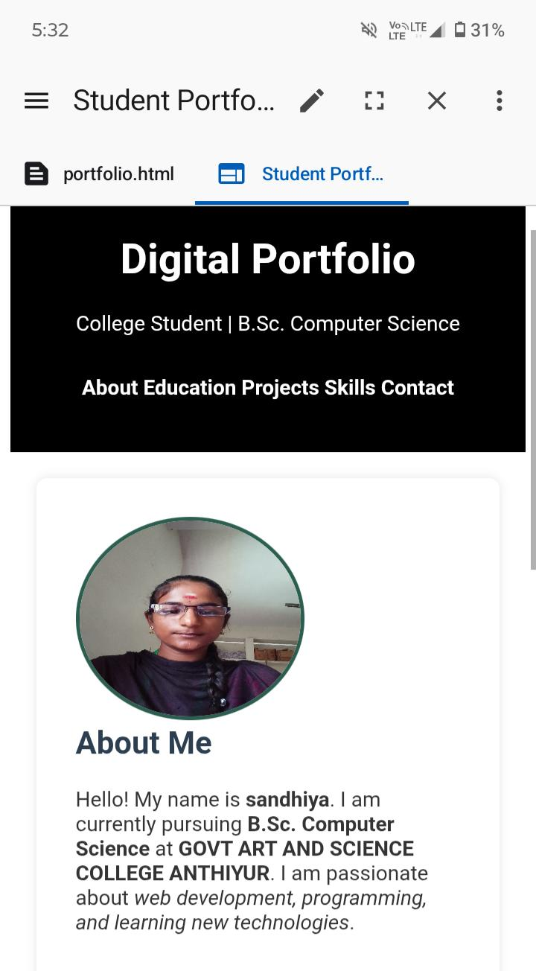

RESULTS AND SCREENSHOTS
3/21/2024 Annual Review
10

Slide 11
CONCLUSION
Conclusion
The project Protifolito was developed to create a simple, creative, and user-friendly digital portfolio. It provides a modern way for individuals to present their skills, projects, and achievements. Unlike traditional resumes, it makes the presentation more attractive and interactive. The layout is clean and divided into clear sections like About, Skills, Projects, and Contact. It is fully responsive, so it works well on desktop, tablet, and mobile devices. Users can easily highlight their academic background, experience, and personal details. The portfolio also allows smooth navigation and a professional look. It is especially useful for students, job seekers, freelancers, and professionals. This project improves self-presentation and helps in creating a strong impression. Overall, Protifolito is a simple but effective solution for showcasing talent and creativity.
11

